Slide 1
A Multi-index Hybrid Trie for IP Lookup and
Updates
Author : Chia-Hung Lin, Chia-Yin Hsu, and Sun-Yuan Hsieh
Publisher : IEEE TRANSACTIONS ON PARALLEL AND DISTRIBUTED SYSTEMS

Slide 2
To reduce the time required by router table operations, this study developed a novel data structure, the multi-index hybrid trie (MIHT), which combines the best features of the B +tree and priority trie to design dynamic router tables. The proposed data structure preserves the advantages of the B + tree and the trie-based data structure and avoids the mentioned shortcomings.

Slide 3
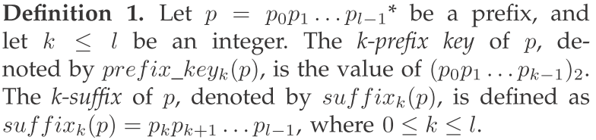
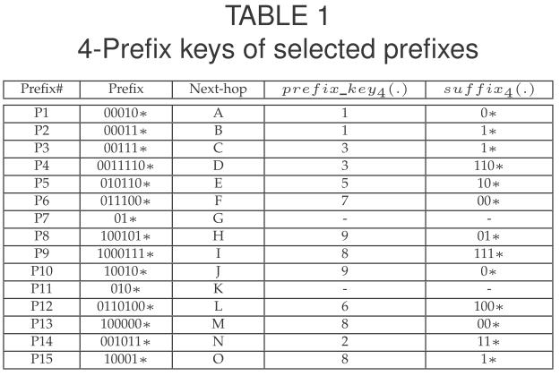
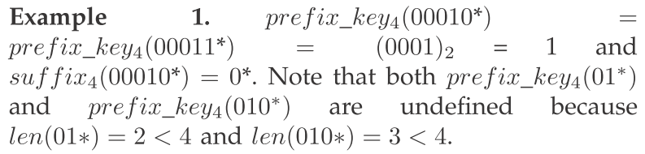
基本架構

Slide 4
主要架構以B+ tree 為主 在配上priority tries
下面是這邊用到的B+ tree的特性
  Each node has at most m children.
  Each node, except the root, has at least m/2 children.
  The root has at least 2 children.
  All leaves occur on the same level.
  For a B + tree, stores all the satellite information in the leaves and stores only keys and child pointers in the internal nodes.
  這邊的key 寄上一頁的

Slide 5
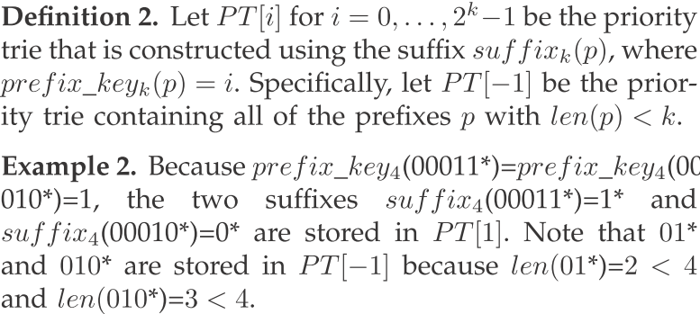
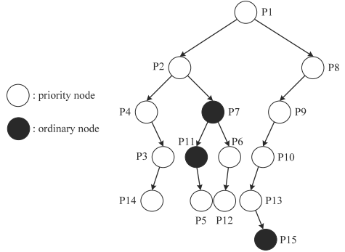
Priority Tries
在他的架構裡面長度不到k的prefix都放在另外的priority trie : PT[-1]

Slide 6
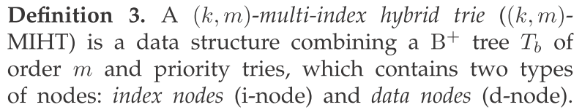
Multi-Index Hybrid Tries(MIHT)
一個(k,m)MIHT 表示key 值為k 且其b+ tree order為m
分為三種node : root, i-node(index node), d-node(data node)

Slide 7
Root
The root is a pointer array with a size of two, root[0] points to the root of PT[−1] and root[1] points to the root of Tb.

Slide 8
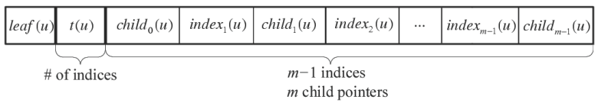
i-node
又分為兩種 : internal i-node 與external i-node
包含以下欄位
  Leaf(u) : indicating whether u is a leaf. For the internal i-node u, leaf(u) is set as FALSE.
  t(u):裡面有幾個index
  t(u)個index :I₁ (u), I₂ (u), . . . , I_{t(u)} (u)
  t(u)+個child-pointers

Slide 9
N-node
Each d-node w had the following ﬁelds:
  priority(w) recorded the boolean value, indicating whether w is a priority node.
  s(w) is the sufﬁx stored in w. 所以如果有match output port就是找
  preﬁx I_{i} (v) · s(w).
  left(w)
  right(w)

Slide 10
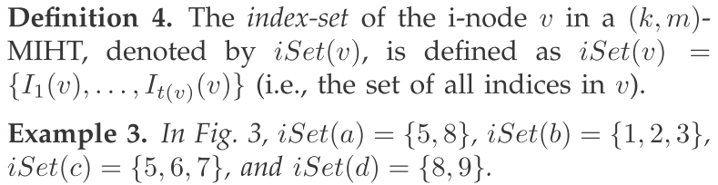
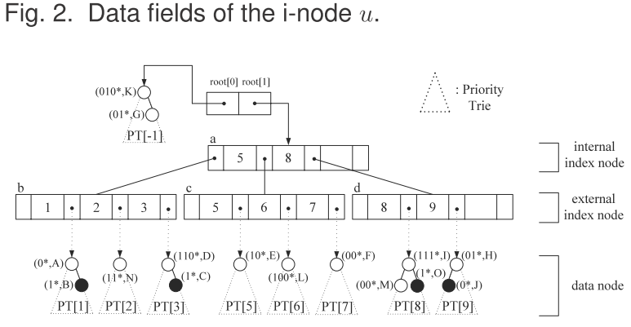

Slide 11
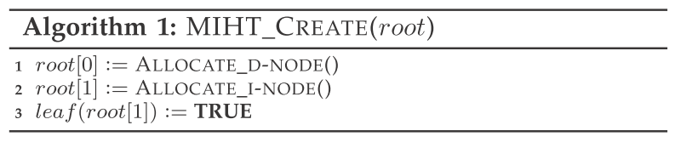
Construction

Slide 12
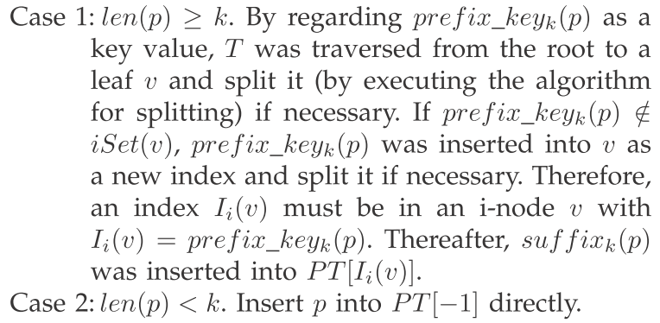
insert

Slide 13
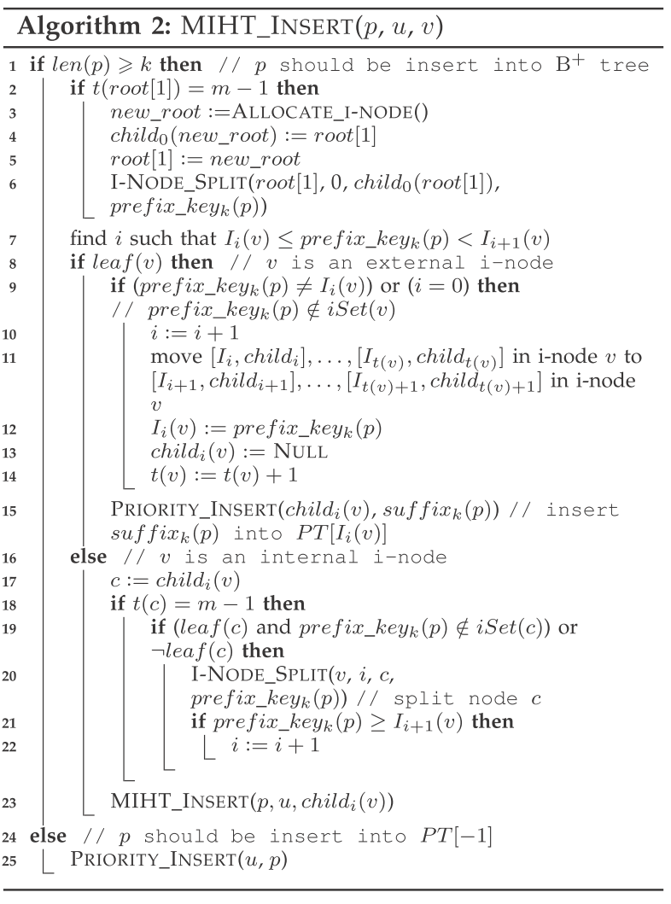

Slide 14
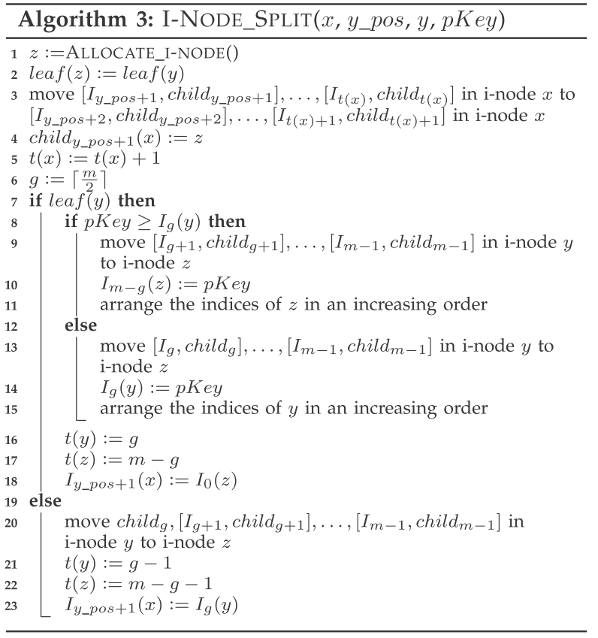

Slide 15
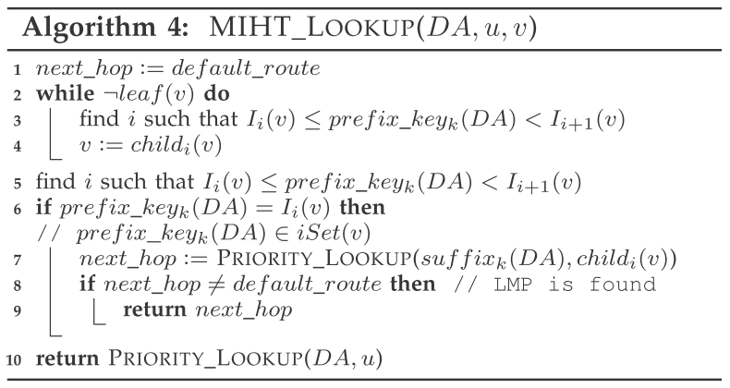
search

Slide 16
deletion
若len < k 去PT[-1] delete掉
若len=>k 則trace到 d-node中的該prefix delete掉他
  若delete後 該priority trie不為空,做 priority trie的調整
  若為空delete掉 external i-node的對應index與pointer 並依照b+ tree的條件去做調整

Slide 17
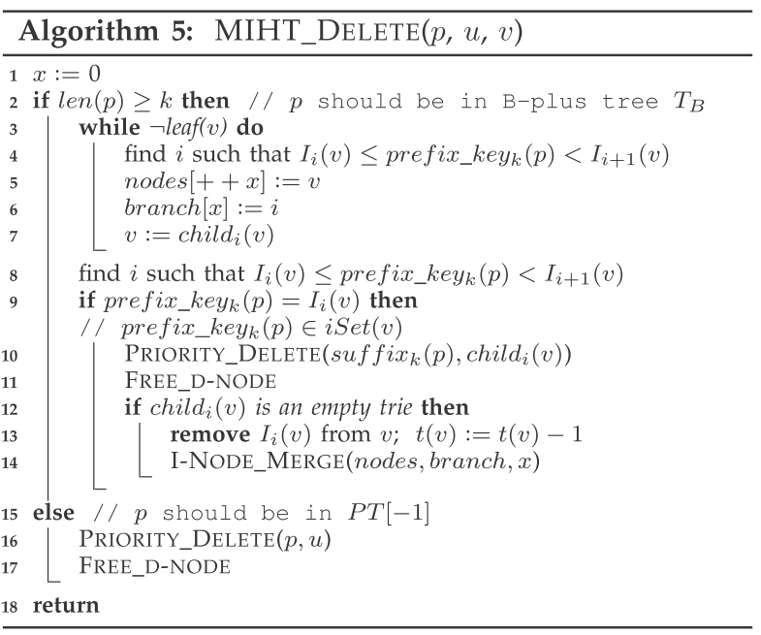

Slide 18
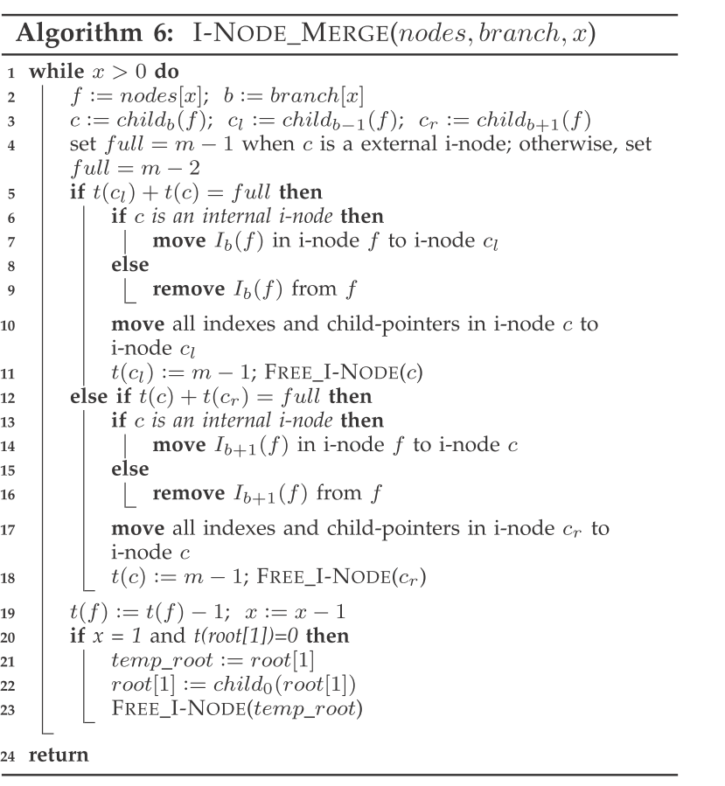

Slide 19
PARTITIONING THE MULTI-INDEX HYBRID
TRIE
對prefix先取a bit依照這個key分成多個MIHT
注意a值不可小魚最短的prefix lenth 否則會有duplicate
For example, assuming that p =101000* and α = 8 (the ﬁrst eight bits of a preﬁx represent the index value), because 101000* contains (10100000) 2 = 160, (10100001) 2 = 161, (10100010) 2 = 162, and (10100011) 2 = 163, p must be inserted into the (k, m)-MIHTs, as indicated by P[160], P[161], P[162], and P[163]

Slide 20
The experiments were performed using C language for four benchmark IPv4 and two benchmark IPv6 preﬁx databases obtained from [1],
. The codes were run on a 3.40GHz Pentium 4 PC that had 1.99GB of memory.

Slide 21
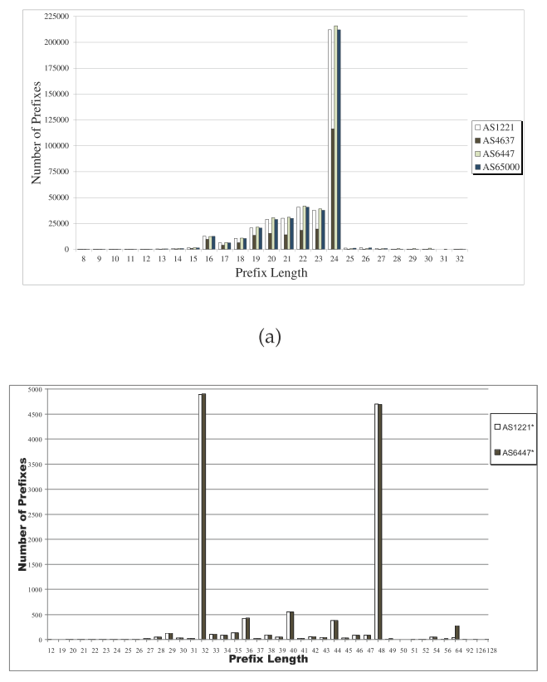

Slide 22
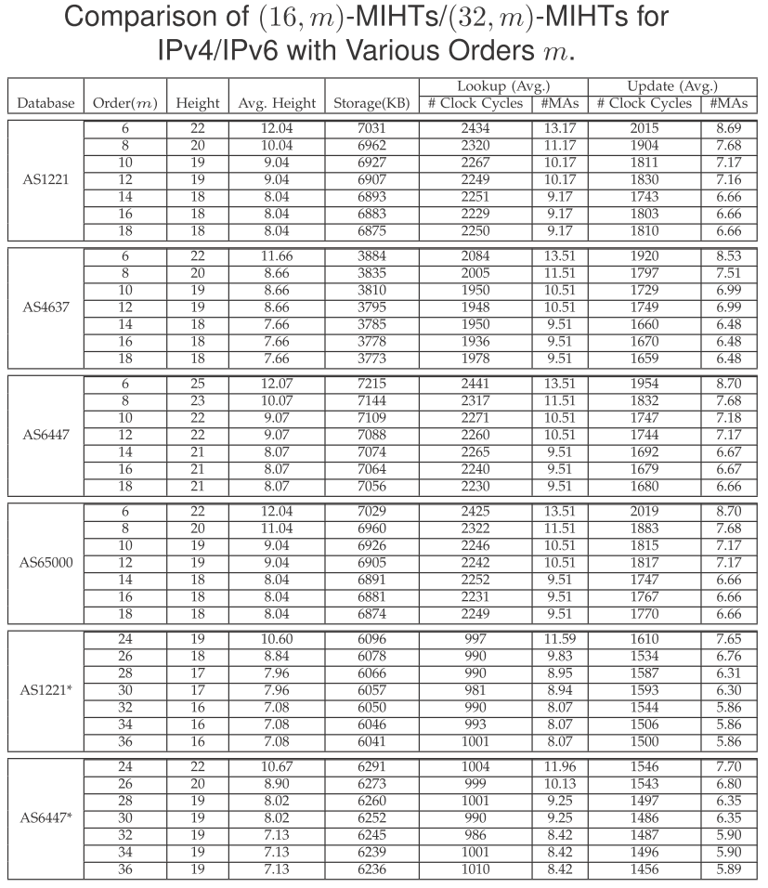
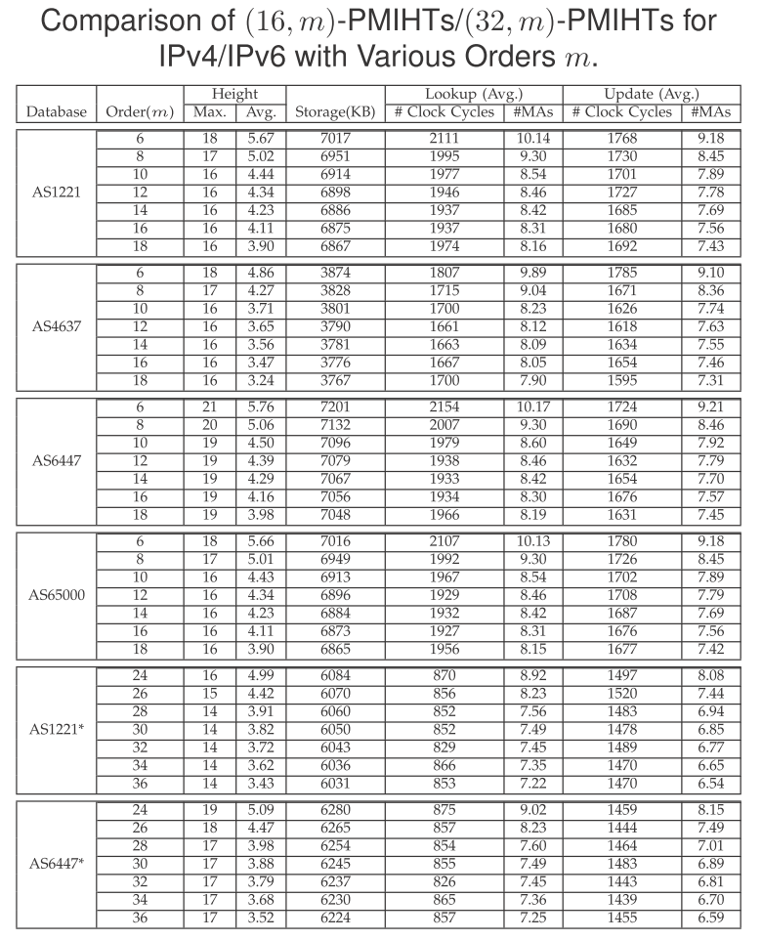

Slide 23
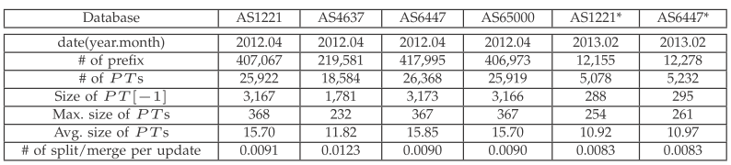

Slide 24
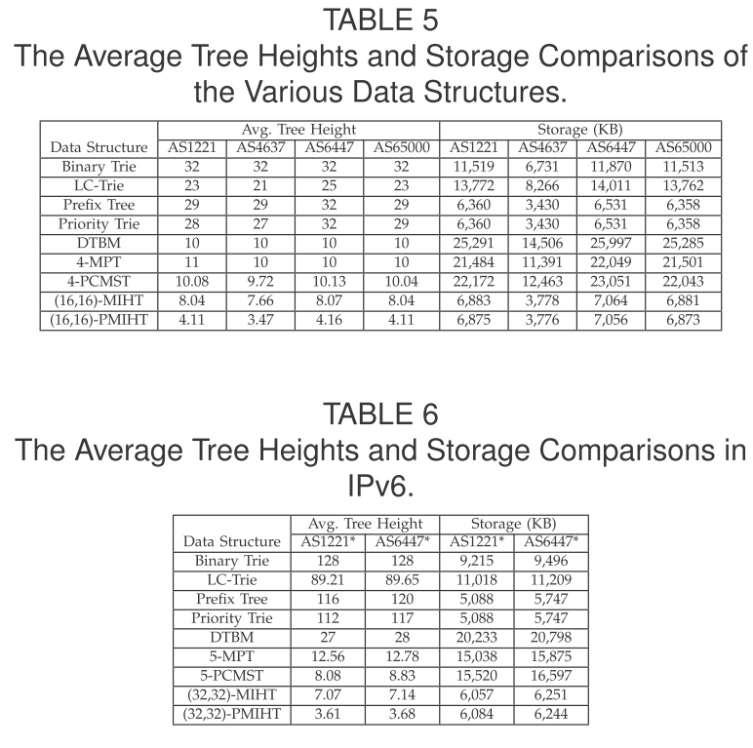

Slide 25
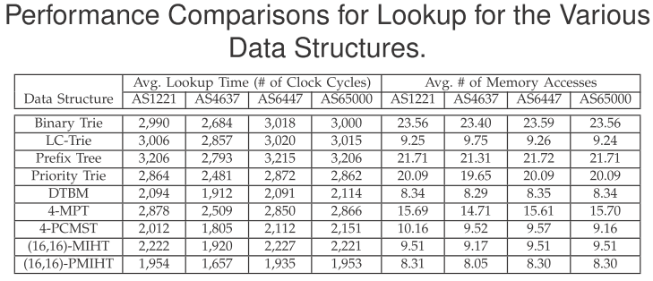

Slide 26
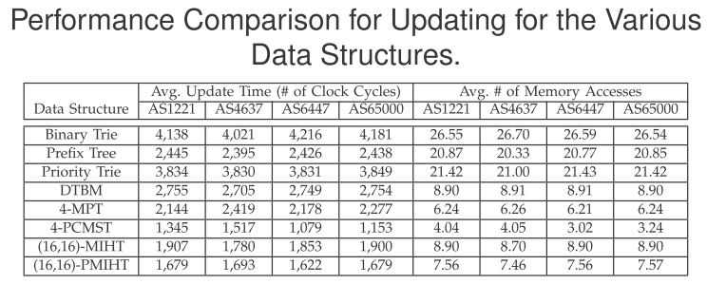

Slide 27
